Slide 1
EFFICIENT ONLINE EXAM GRADING
UNDER THE GUIDANCE OF:
DR. P. PRATHAP NAYUDU M.Tech.,Ph.D.
ASSOCIATE PROFESSOR
DEPARMENT OF CSE
RGMCET, NANDYAL
TEAM MEMBERS:
R. ISWARYA RANI – 20091A0556
P. SRINIVAS – 20091A05F9
S. TAUHEED BASHA – 20091A05H3
S. SAMEER – 20091A05D7

Slide 2
CONTENTS:
Abstract
Introduction
Literature Review
Problem Statement
Objectives
Methodologies
Requirements
System Architecture
Modules
Implementation
System Design
Overview
References

Slide 3
ABSTRACT:
This project proposes a sophisticated software solution designed to assess and score subjective answers with human-like precision in online examinations.
This application is tailored to evaluate written responses provided by users and assign marks based on a comparison with predefined correct answers stored in a database.
This feature is accessible to administrators who can input questions and corresponding subjective answers, which are stored as notepad files within the system.
When a user takes an online test, they are presented with questions and a designated area to enter their responses.
Once the user submits their answers, the system employs artificial intelligence sensors to compare the user's response with the original answer stored in the database.

Slide 4
Notably, the system does not demand an exact word-for-word match between the user's response and the reference answer. Instead, it employs advanced algorithms to assess the similarity and relevance of the responses, emulating the assessment process conducted by human evaluators.
This system offers a reliable and efficient means of evaluating subjective answers, ensuring fairness and accuracy in online examinations.
By harnessing artificial intelligence, it mimics human evaluation processes, providing a robust solution for grading subjective responses in online assessments.

Slide 5

INTRODUCTION TO ARTIFICIAL INTELLIGENCE
Artificial Intelligence (AI) is a broad field of computer science that focuses on creating systems and machines capable of performing tasks that typically require human intelligence.
AI aims to develop algorithms and models that enable machines to learn, reason, problem-solve, perceive, and communicate in ways similar to how humans do.
The ultimate goal is to simulate human-like intelligence or to create machines that can out perform humans in specific cognitive tasks.

Slide 6
FEATURES OF AI:
Learning
Reasoning
Problem Solving
Perception
Natural Language Processing
Adaptability
Autonomy
Interaction
Prediction
Self Correction

Slide 7
APPLICATIONS:
Self Driving Cars
Boston Dynamics
Navigation Systems
ASIMO
Chatbots
Human vs Computer Games

Slide 8
LITERATURE SURVEY
S.NO | TITLE | PUBLISH YEAR | AUTHOR | METHODOLOGIES | LIMITATIONS
1. | Subjective Answers Evaluation Using Machine Learning and Natural Language Processing | 2021 | Muhammad Farrukh, Hamza Arshad | Natural language processing techniques like word2vec, wordnet, TF-IDF and Machine learning algorithms like Multinomial Navie Bayes algorithm | Lack of diverse and large scale data, difficulty in understanding how grades are assigned, Word2vec requires more memory and processing power
2. | Automatic Subjective Answer Evaluation | 2023 | Kumari.V, Godbole. P and Sharma. Y | Cosine similarity, BM25, Term Frequency Inverse Document Frequency, Count Vectorizer | Depends on predefined criteria, need for large and diverse training data, difficulty in adapting to new techniques
3. | Automatic Answer Evaluation Using Machine Learning | 2021 | Nandita Bharambe, Pooja Barhate, Prachi Dhannawat | Text extraction using OCR, Back Propagation algorithm, Natural Language Processing, Artificial neural network | Inability to handle synonyms and variations, Difficulty with ambiguous answer

Slide 9
S.NO | TITLE | PUBLISH YEAR | AUTHOR | METHODOLOGIES | LIMITATIONS
4. | Subjective Answer Grader System Based on Machine Learning | 2020 | Avani Sakhapara, Dipti Pawade, Bhakti Chaudhari, Rishabh Gada, Aakash Mishra and Shweta Bhanushali | Latent semantic analysis, Information gain, Wordnet | Complexity and computation time is more, Difficulty in handling polysemy, lack of human creativity assessment
5. | AI Based Symmetric Answer Evaluation System for Descriptive Answering | 2020 | A. K. Ghavat, B. G.Tekade, V. S. Bhute, M.D.Chikhalkar, P. Vijaykar | Keyword based evaluation, Hyperspace analog to language, Self organizing map, | Difficulty with sentence structure, depending on human provided knowledge, difficulty with uncommon terms
6. | Online Subjective answer verifying system Using Artificial Intelligence | 2019 | Jagadamba G, Chaya Shree G | Natural language processing, machine learning, pattern recognition | Difficulty in nuanced understanding, cost is more, inability to grasp concepts perfectly

Slide 10
PROBLEM STATEMENT:
The current state of automated answer evaluation systems for subjective responses faces critical challenges that hinder their effectiveness, transparency, and scalability. To address these limitations, there is an urgent need for an advanced automatic answer checking application that overcomes data scarcity issues, optimizes resource utilization, promotes transparency in grading methodologies, and ensures adaptability to emerging AI techniques.

Slide 11
OBJECTIVES:
Automatically evaluate and grade subjective answers
Ensure the application assesses and scores answers with high precision and accuracy
Streamline the evaluation process to save time

Slide 12
METHODOLOGIES:
Requirements Analysis and Specification : Gather comprehensive requirements, understanding the needs, and defining the desired features and functionalities of the Automatic Answer Checker.
Data Collection and Preparation : Gather a diverse dataset of questions and corresponding subjective answers for training and testing the AI model. Annotate and preprocess the data to ensure it's suitable for training AI algorithms.
Bidirectional Encoder Representations from Transformers (BERT): BERT is a NLP model that forms the basis of the system.

Slide 13
Keyword extraction and highlighting: This method extracts keywords from the model answer and the student's answer and highlights them. It helps in providing qualitative feedback and identifying the key points in the answers.
Machine Learning Model Selection : Research and select appropriate machine learning models for assessing subjective answers. Models like natural language processing (NLP) techniques, deep learning (e.g., recurrent neural networks, transformers), and similarity algorithms may be considered.

Slide 14
REQUIREMENTS:
SOFTWARE REQUIREMENTS:
Windows 8 Operating System
Visual Studio
Python Programming Language

Slide 15
HARDWARE REQUIREMENTS:
Memory(8GB RAM)
Computing Hardware
Internet Connectivity

Slide 16
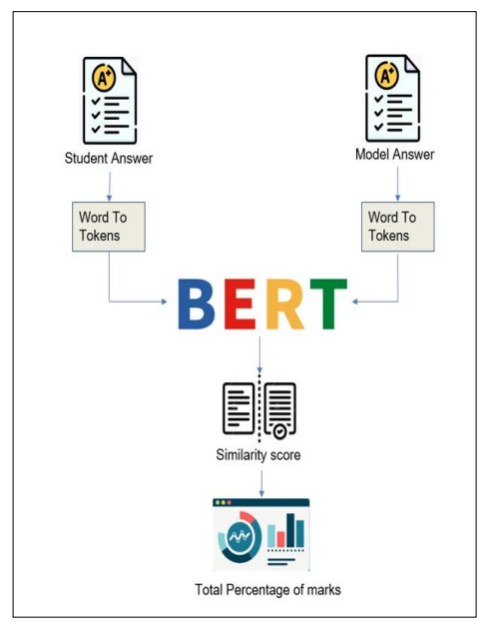
SYSTEM ARCHITECTURE

Slide 17
MODULES
Preprocessing Module: It includes tokenization, lowercasing, removing stop words, punctuation, and special characters, as well as stemming or lemmatization.
Feature Extraction Module: It extracts relevant features from the preprocessed text that can be used as input to the machine learning models.
Machine Learning Model Module: BERT is a pretrained language model that can be fine-tuned to solve specific problem.
Training Module: This module is responsible for training the machine learning models using labeled training data.

Slide 18
Evaluation Module: This module evaluates the performance of the trained models using evaluation metrics such as accuracy, precision, recall, F1-score, or Mean Squared Error (MSE), depending on the specific task and requirements.
Integration Module: Once trained and evaluated, the machine learning models need to be integrated into an application or system where they can receive input responses, perform evaluation, and output results.

Slide 19
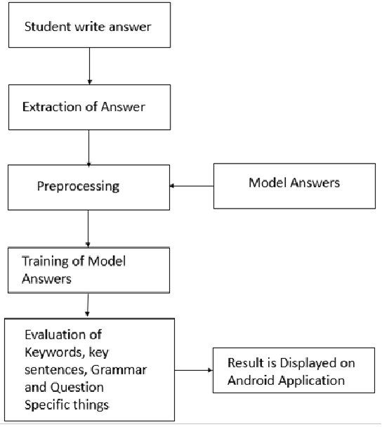
SYSTEM DESIGN

Slide 20
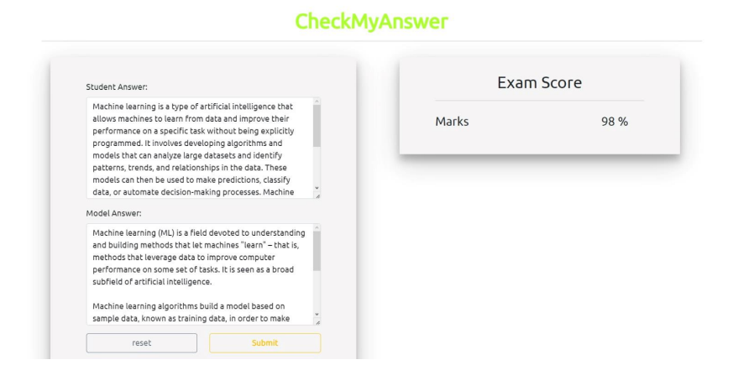
IMPLEMENTATION

Slide 21
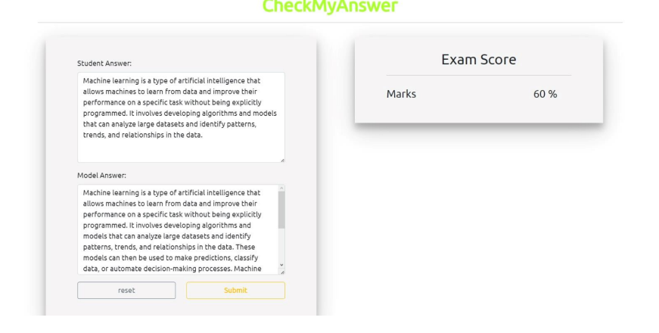

Slide 22
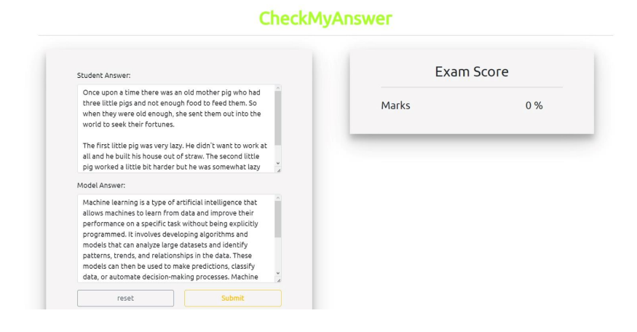

Slide 23
OVERVIEW
The software represents a significant advancement in online exam assessment by integrating sophisticated AI algorithms.
It assesses subjective responses with human-like precision, using advanced algorithms for response similarity and relevance instead of exact word matches.
The innovation enhances grading efficiency and accuracy, closely resembling the nuanced assessment process conducted by human evaluators.
By leveraging AI-driven technology, the system ensures fairness and reliability in evaluating subjective answers.

Slide 24
REFERENCES:
M. F. Bashir, H. Arshad, A. R. Javed, N. Kryvinska and S. S. Band, "Subjective Answers Evaluation Using Machine Learning and Natural Language Processing," in IEEE Access, vol. 9, pp. 158972-158983, 2021, doi: 10.1109/ACCESS.2021.3130902.
Kumari, Vijay, Prachi Godbole, and Yashvardhan Sharma. "Automatic Subjective Answer Evaluation." (2023).
Bharambe, Nandita, Pooja Barhate, and Prachi Dhannawat. "Automatic answer evaluation using machine learning." Int. J. Inf. Technol.(IJIT) 7.2 (2021).

Slide 25
Sakhapara, Avani, et al. "Subjective answer grader system based on machine learning." Soft Computing and Signal Processing: Proceedings of ICSCSP 2018, Volume 2. Springer Singapore, 2019.
Ghavat, A. K., et al. "AI based symmetric answer evaluation system for descriptive answering." International Research Journal of Modernization in Engineering Technology and Science (IRJMETS) 2.03 (2020).
Jagadamba, G. "Online subjective answer verifying system using artificial intelligence." 2020 Fourth International Conference on I-SMAC (IoT in Social, Mobile, Analytics and Cloud)(I-SMAC). IEEE, 2020.

Slide 26
ANY QUERIES ?

Slide 27
THANK YOU

